Slide 1
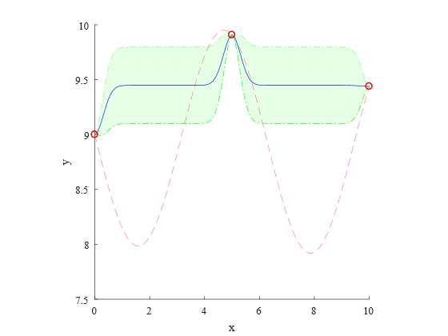
Kringing model
Real function
± 1 σ (sigma)
3 samples

Slide 2
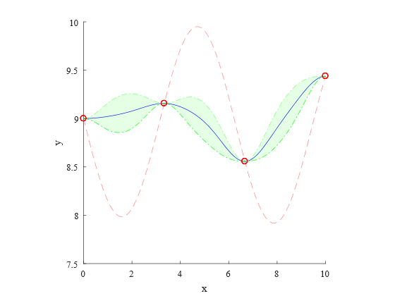
Kringing model
Real function
± 1 σ (sigma)
4 samples

Slide 3
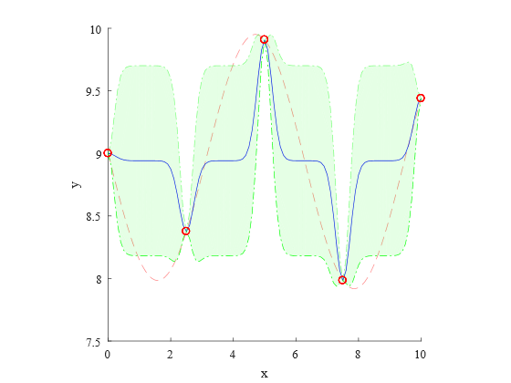
Kringing model
Real function
± 1 σ (sigma)
5 samples

Slide 4
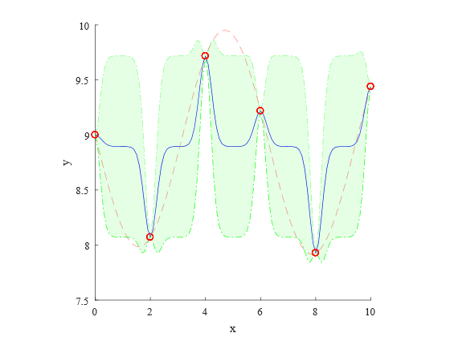
Kringing model
Real function
± 1 σ (sigma)
6 samples

Slide 5
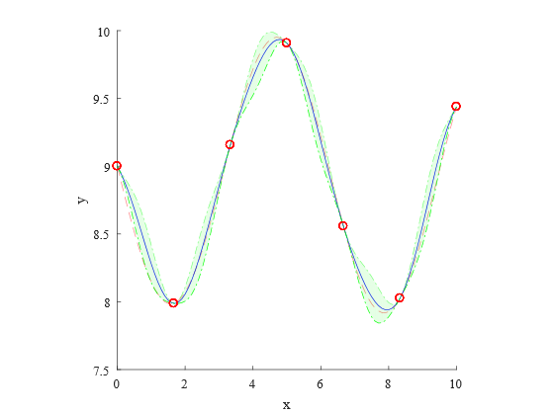
Kringing model
Real function
± 1 σ (sigma)
7 samples

Slide 6
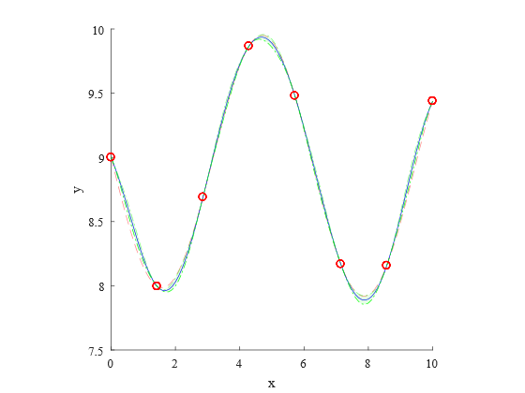
Kringing model
Real function
± 1 σ (sigma)
8 samples

Slide 7

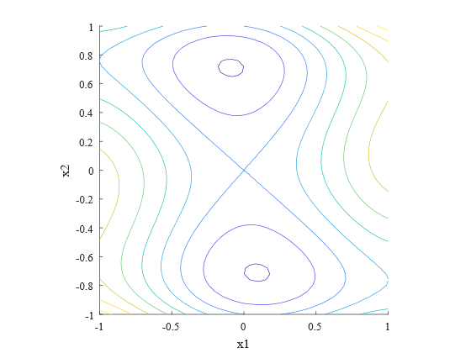
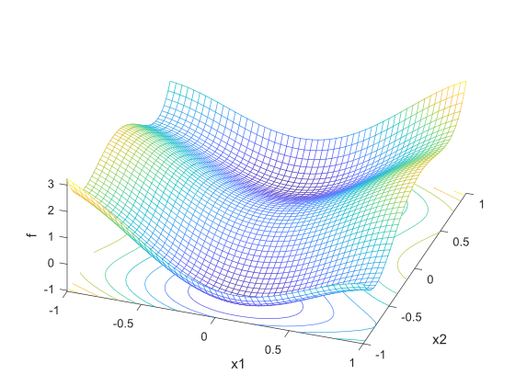

Slide 8
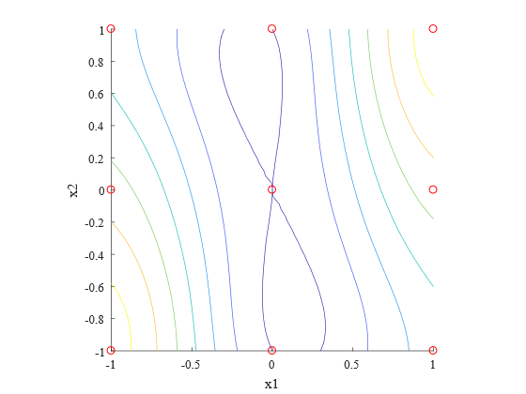
9 samples

Slide 9
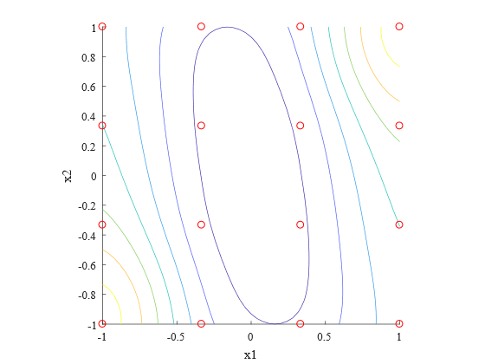
16 samples

Slide 10
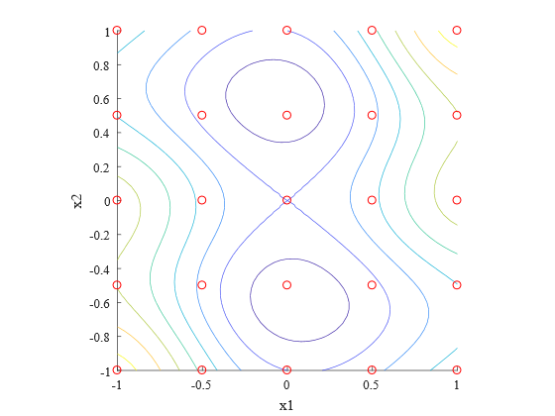
25 samples

Slide 11
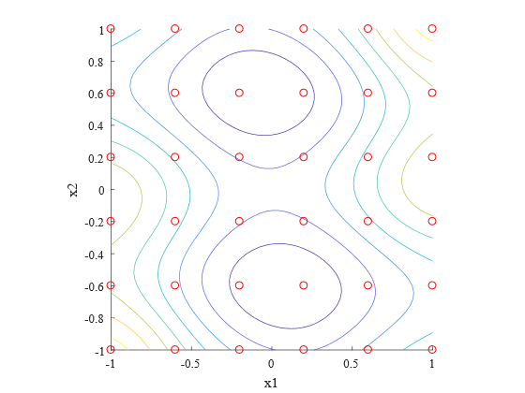
36 samples

Slide 12
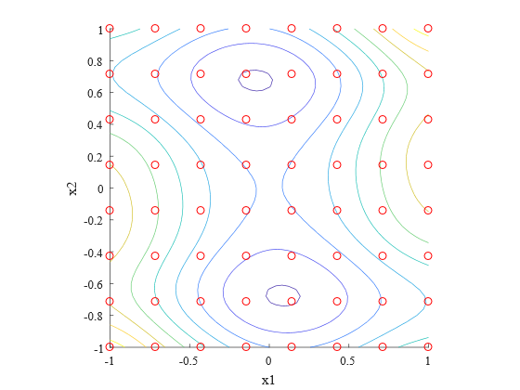
49 samples

Slide 13
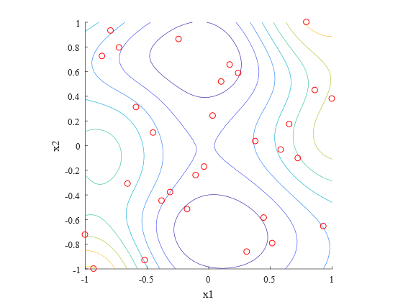
30 samples
Latin hypercube

